Slide 1





AGRICULTURAL RAW MATERIAL ANALYSIS
STUDENT DETAILS:
NAME: KAVIN R
NM ID: au2021109018
D72FCF3AA5398BEB86147C32B30CBAFA
COLLEGE NAME: COLLEGE OF ENGINEERING GUINDY, ANNA UNIVERSITY

Slide 2
COURSE OUTLINE
Abstract
Problem statement
Aims and objectives
System deployment approach
Model development and algorithm
Future scope
Video of the project
Conclusion
Reference

Slide 3
ABSTRACT
The agricultural sector plays a crucial role in global economies, with raw material prices serving as vital indicators of market dynamics. This study conducts an Exploratory Data Analysis (EDA) on a comprehensive dataset spanning multiple years to discern trends, identify high and low-range raw materials based on prices, analyze %Change dynamics, and map correlations between various agricultural commodities.
The research employs statistical and data visualization techniques to unveil insights into the fluctuating landscape of agricultural raw material prices. By scrutinizing the dataset, high-range and low-range materials are identified based on their pricing trends over the analyzed period. Additionally, %Change analysis provides a deeper understanding of the volatility and stability exhibited by different commodities.

Slide 4
CONT..
Furthermore, the study investigates the range of price fluctuations over the years, shedding light on the magnitude of variability within the agricultural sector. Through heatmap correlation mapping, relationships between raw materials are explored, uncovering potential interdependencies and market dynamics.
The findings of this research contribute to a better understanding of agricultural market trends, aiding stakeholders in strategic decision-making, risk management, and market forecasting

Slide 5
PROBLEM STATEMENT
The objectives of the project will enable a comprehensive understanding of the agricultural raw materials market, allowing stakeholders to make informed decisions regarding investment, trading, and risk mitigation strategies.

Slide 6
AIM AND OBJECTIVES
AIM:
The aim is to conduct Exploratory Data Analysis (EDA) to identify high-range and low-range raw materials based on their prices, determine the raw materials with the highest and lowest percentage changes in prices, investigate the range of price changes over the years, and map the correlation between different raw materials using a heatmap.

Slide 7
CONT..
OBJECTIVES:
The objectives of the project aiming to conduct Exploratory Data Analysis (EDA) to
identify high-range and low-range raw materials based on their prices, determine the raw materials with the highest and lowest percentage changes in prices,
investigate the range of price changes over the years, and map the correlation between different raw materials using a heatmap

Slide 8
SYSTEM DEPLOYMENT
Data collection
Data cleaning and preprocessing
Exploratory data analysis tools selection
System architecture design
Documentation and training
Deployment
Testing and validation
EDA implementation

Slide 9
MODEL DEVELOPMENT AND ALGORITHM
To analyze the agricultural raw material prices dataset, you can follow these steps:
Data Collection: Obtain the agricultural raw material prices dataset containing information about various raw materials and their prices over the years.
Exploratory Data Analysis (EDA): Conduct exploratory data analysis to understand the dataset's structure, distribution, and relationships between variables. This may include:
Summarizing the dataset (e.g., mean, median, range, standard deviation).
Visualizing the distribution of prices for each raw material over the years (e.g., line plots, histograms).
Identifying outliers and missing values.
Calculating the percentage change in prices for each raw material over time.

Slide 10
CONT..
3.Finding High-Range and Low-Range Raw Materials:
Identify raw materials with consistently high prices over the years (high-range raw materials).
Identify raw materials with consistently low prices over the years (low-range raw materials).
4.Calculating High and Low % Change Materials:
Calculate the percentage change in prices for each raw material over consecutive years.
Identify raw materials with the highest percentage increase (high % change) and the highest percentage decrease (low % change).

Slide 11
CONT..
5.Analyzing Price Range Changes Over the Years:
Determine the range of prices for each raw material over the years.
Visualize the changes in price ranges using line plots or bar plots.
6.Mapping Correlation Using Heatmap:
Calculate the correlation matrix between different raw materials based on their price variations over the years.
Visualize the correlation matrix using a heatmap to identify relationships between raw materials (e.g., positive or negative correlations).
Here's a general outline of the steps involved in analyzing the agricultural raw material prices dataset. Depending on the specific dataset and requirements, you may need to tailor these steps accordingly. Additionally, you would need to implement these steps using programming languages and libraries such as Python with pandas, NumPy, matplotlib, and seaborn for data manipulation, analysis, and visualization.

Slide 12
FUTURE SCOPE
Interpreting Results: Interpret the findings from the analysis to extract meaningful insights for stakeholders. This may involve identifying key drivers of price movements, understanding market dynamics, and assessing the impact of external factors such as weather conditions, geopolitical events, and economic policies.
Recommendations and Future Predictions: Based on the analysis results, provide recommendations for stakeholders such as farmers, traders, and policymakers. Additionally, explore the potential for developing predictive models to forecast future price movements and mitigate risks associated with agricultural raw material markets.
Thus Analyzing an agricultural raw material prices dataset and conducting exploratory data analysis (EDA) offers valuable insights into market trends, price volatility, and potential correlations between different commodities.

Slide 13
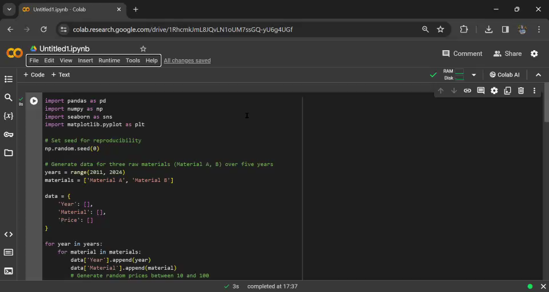
VIDEO OF THE PROJECT

Slide 14
CONCLUSION
By identifying both high-range and low-range raw materials based on their prices, as well as calculating the high and low percentage changes, we have gained a comprehensive understanding of the market dynamics.
Moreover, examining the range of price changes over the years has shed light on the volatility and stability of different agricultural commodities. This information is crucial for stakeholders to make informed decisions regarding investment, trading, and risk management in the agricultural sector.

Slide 15
CONT..
Correlation between various raw materials using a heatmap has allowed us to discern any interdependencies or patterns in their price movements. This correlation analysis aids in identifying potential market trends and opportunities for diversification or hedging strategies.
Overall, this EDA has not only provided a snapshot of historical price trends but also laid the groundwork for predictive modeling and further analysis to enhance decision-making processes in the agricultural industry.

Slide 16
REFERENCES
https://www.analyticsvidhya.com/blog/2022/07/step-by-step-exploratory-data-analysis-eda-using-python/
https://builtin.com/data-science/EDA-python

